Slide 1
Cooking Chatbot
Group 3 – A1803 – FPT Univesity

Slide 2
Members
Đỗ Tuấn Kiệt
Trần Gia Hiển
Huỳnh Nhựt Huy
Nguyễn Minh Quân
Trần Phương Nam
Bùi Nhật Anh

Slide 3
Techstack used
Programing Language: Python
Library: Langchain (and its module, class)
Frontend/Web app: Flask
Large Language Model: CTransformers
Vector Database: Chroma

Slide 4
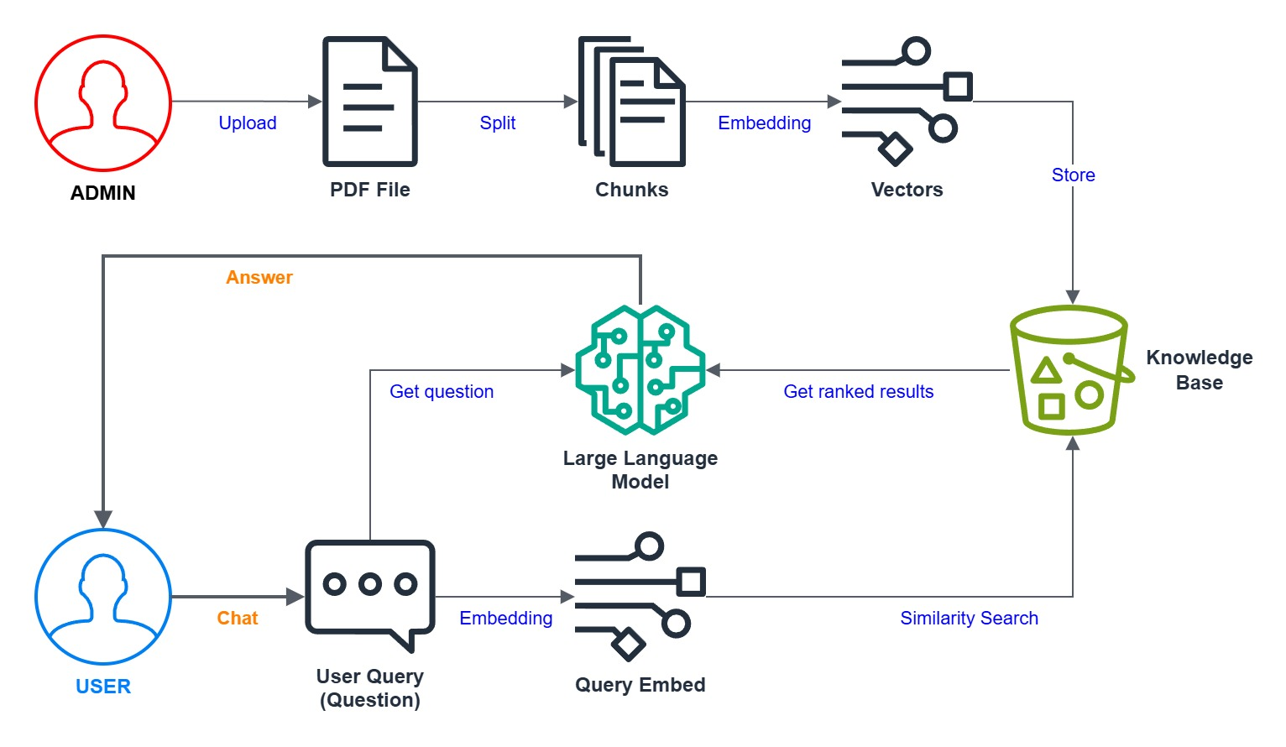
Architecture

Slide 5
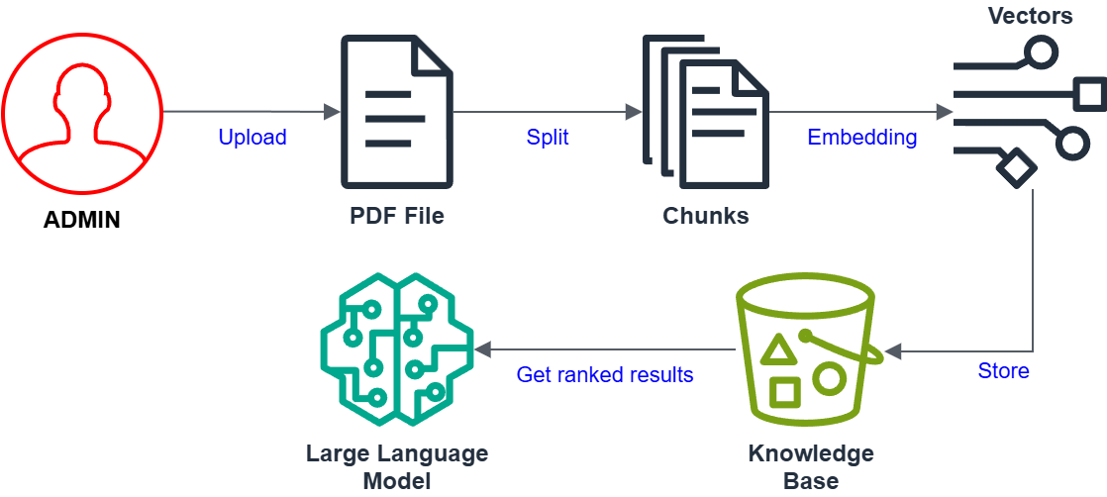
ADMIN Side

Slide 6
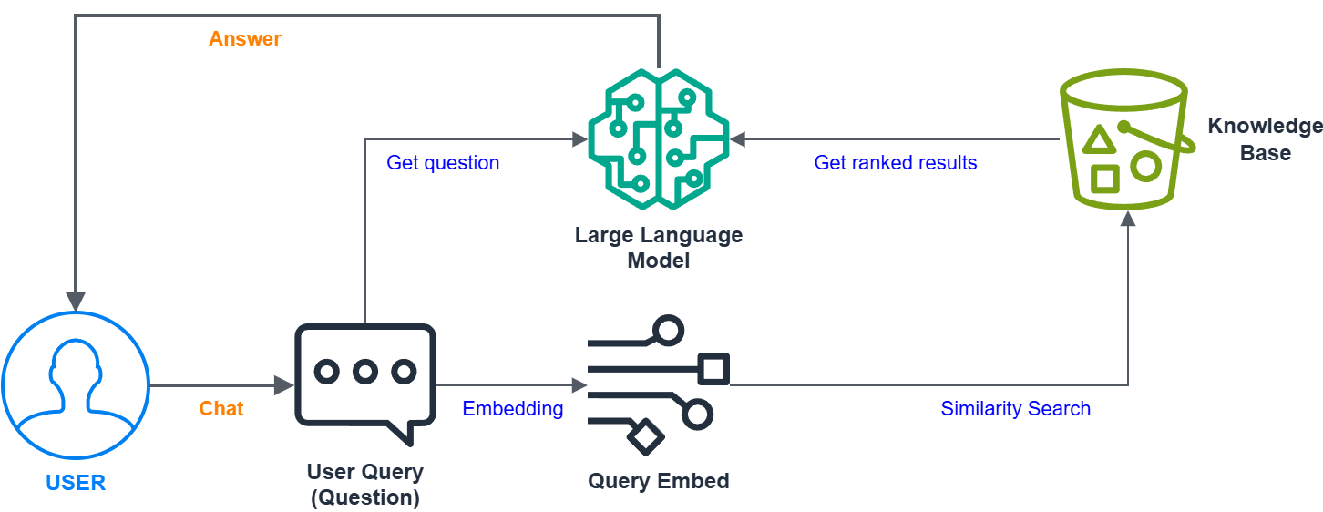
USER Side

